Slide 1
Graph Databases with Azure CosmosDB
Patrick Flynn | Link Group Australia

Slide 2




Patrick Flynn SQL Server DBA Link Group Australia Group
MCM – SQL Server 2008
MCSM – Data Platform
Production DBA for 10+ years.
Presentations available at:
https://github.com/sqllensman/Presentations
sqlsaturday@sqllensman.com
@sqllensman
Patrick Flynn

Slide 3


Thanks to our Sponsors
SILVER:
Global Alliance Partner
PASS:
VENUE:
Singapore

Slide 4
Agenda
What is a Graph Database?
Why are they useful?
What problems do they solve?
Implemention in Cosmos DB

Slide 5
Graph Databases ?

Slide 6
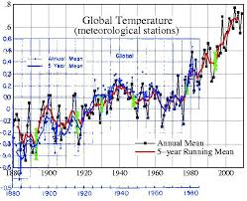
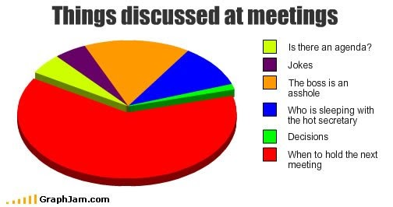
This session is NOT about
Notes:
What is not Graph Data
If you are here hoping to learn how to make pretty pictures of your data then I’m afraid this is not what we are talking about today.

Slide 7
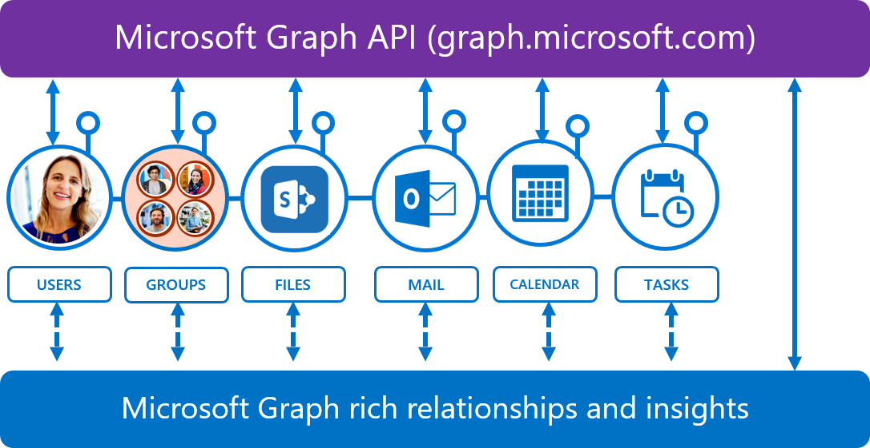
It is also NOT about

Slide 8
It is about ?

Slide 9
Graph Theory

Slide 10
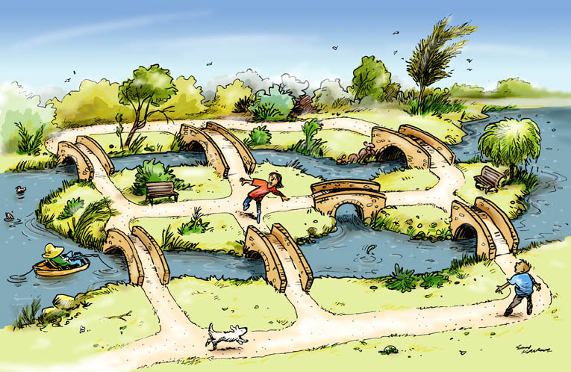

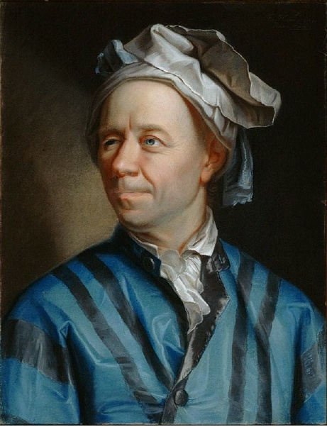
Origin: The Königsberg Bridge Problem
Leonhard Euler (1707–1783)
Can you take a walk through the town, visiting each part of the town and crossing each bridge only once?
Notes:
The Königsberg Bridge Problem
Our story begins in the 18th century, in the town of Königsberg, Prussia on the banks of the Pregel River
The city built seven bridges across the river dividing the city into four distinct regions
The citizens of Königsberg used to spend Sunday afternoons walking around the city.
They devised a game for themselves, their aim was to find a way in which they could walk around the city, crossing each of the seven bridges only once.
Even though none of the citizens of Königsberg could find a route that would allow them to cross each of the bridges only once, no one could prove, mathematically, that it was impossible.
The famous mathematician, Leonhard Euler, was asked to find a solution and although initially uninterested eventually became intrigued by it.
In 1731 Euler published a paper that solved the problem and, at the same time, gave birth to the subject of graph theory.
On August 26, 1735, Euler presented a paper that addressed both this specific problem, as well as a general solution with any number of landmasses and any number of bridges.
This paper, called ‘Solutio problematis ad geometriam situs pertinentis,’ (The solution of a problem relating to the geometry of position) was later published in 1741

Slide 11
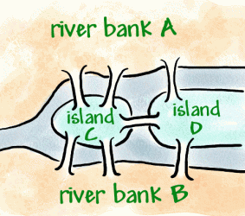
Solving the Königsberg Bridge Problem
A
3
1
2
C
7
D
4
5
6
B
Notes:
The Königsberg Bridge Problem
Euler simplified the problem
We effectively have four land masses (A, B, C and D)
And seven bridges connecting those land masses (1-7).
He turned the land masses into single points (which he called nodes)
and the bridges as lines connecting the nodes (which he called edges or vertices)
// Euler had put the essential features of Königsberg into a graph.

Slide 12
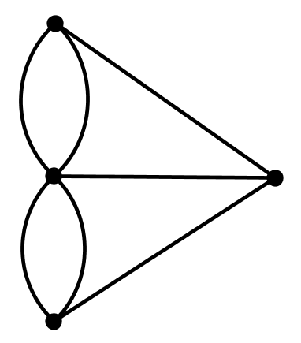
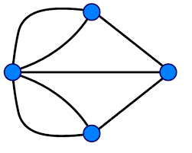
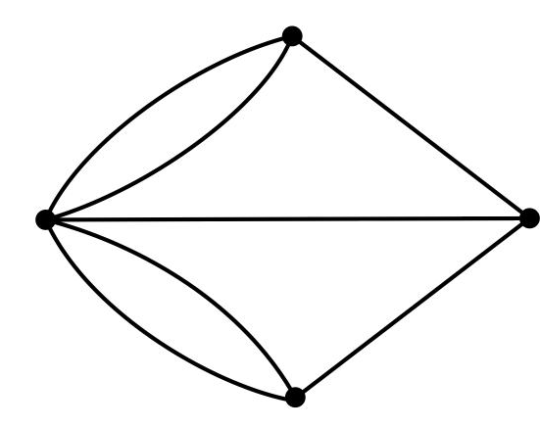
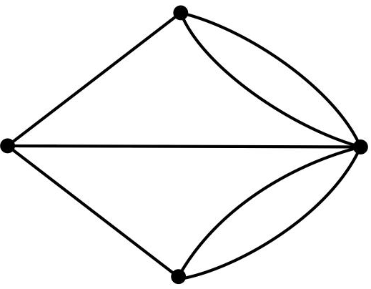
Solving the Königsberg Bridge Problem
A
C
D
B
Notes:
The Königsberg Bridge Problem
Let’s remove the picture and what we end up with, in mathematical terms, is a graph. We can draw this in whatever shape we like but it is still the same graph
We can restate our challenge like this:
Starting at any of the four nodes A, B, C or D, find a path through the graph such that you travel across each edge exactly once.
In simple terms, what Euler found was:
The graph is traversable if:
If all nodes are even (there are zero odd nodes)
Or
exactly two nodes are odd and the remaining nodes are even
In Königsberg all four nodes have an odd number of edges. Therefore we don’t meet the requirements so there is no Eulerian path.
In graph theory, an Eulerian trail (or Eulerian path) is a trail in a finite graph which visits every edge exactly once.
Similarly, an Eulerian circuit or Eulerian cycle is an Eulerian trail which starts and ends on the same node
A more long winded explanation
What Euler found was:
If a node has an even number of edges, then if you start at that node (and you traverse each edge exactly once), then you must also end your route at that same node.
But,
If a node has an odd number of edges, then if you start at that node (and you traverse each node exactly once) then you must end your route at some other node.
If a node has an even number of edges, then if you start at that node (and you traverse each edge exactly once), then you must also end your route at that same node.
But,
If a node has an odd number of edges, then if you start at that node (and you traverse each node exactly once) then you must end your route at some other node.
Start your walk at node A. Now move to node C. Node C has five edges, however, you’ve already used one of them (you might think about this as literally “burning your bridges” every time you cross an edge), so it’s as if you’re now starting at a node with an even number of edges.
We know from the previous paragraph that means your route must end at node C.
Now move to node D, which also has an odd number of edges. Again you’ve used up one edges and you’re left with an even number of edges at node D, which implies your route must also end at node D.
But we’ve just established that your route must end at node C so we have a contradiction, Thus, given your starting path (A->C->D), no route meeting the required conditions is possible.
Therefore, it doesn’t really matter where you start – the second node you visit is going to have an even number of edges left after you arrive there and, therefore, we must end our route on that second node. But the same thing will be true of the third node we visit. So, regardless of the path we take through our first three nodes, we’re going to conclude that our path must end at our second AND third nodes. No route could end in two places so we’ve effectively proven, by contradiction, that no possible route can be found which satisfies our conditions.

Slide 13
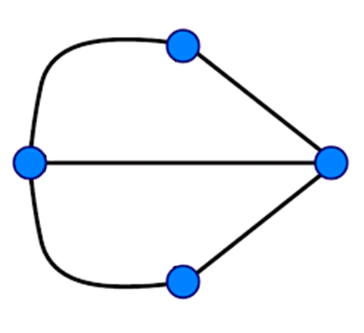
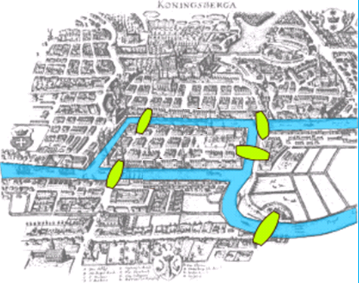
Kaliningrad Today
A
C
D
B
Notes:
Kaliningrad Today
Two of the seven original bridges did not survive World War II.
And Königsberg is now part of Russia called Kaliningrad.
So there are now only five bridges in Kaliningrad.
If we represent the town as a graph we get:
Node A has 2 degrees
Node B has 2 degrees
Node C has 3 degrees
Node D has 3 degrees
In terms of graph theory, we have two even and just two odd nodes
Therefore, an Eulerian path is now possible, but it must begin on one island and end on the other

Slide 14
Graph Theory: Directed Graph
Definition
In formal terms, a directed graph is an ordered pair G = (V, A) where
V is a set whose elements are called vertices, nodes, or points;
A is a set of ordered pairs of vertices, called arrows, directed edges (sometimes simply edges with the corresponding set named E instead of A), directed arcs, or directed lines.
Notes:
Warning:

Slide 15
Graph Data

Slide 16
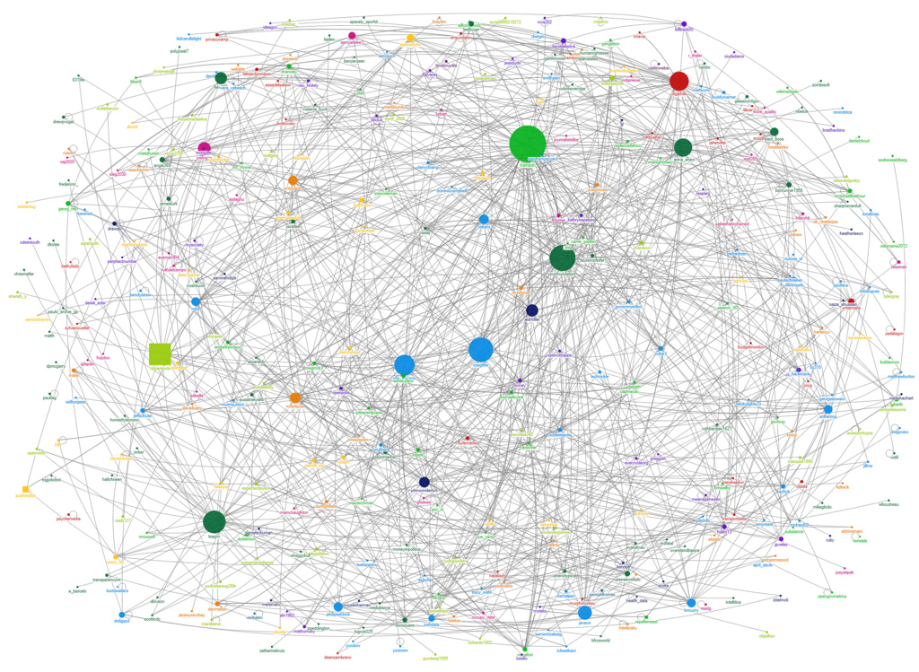
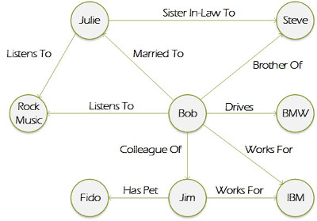
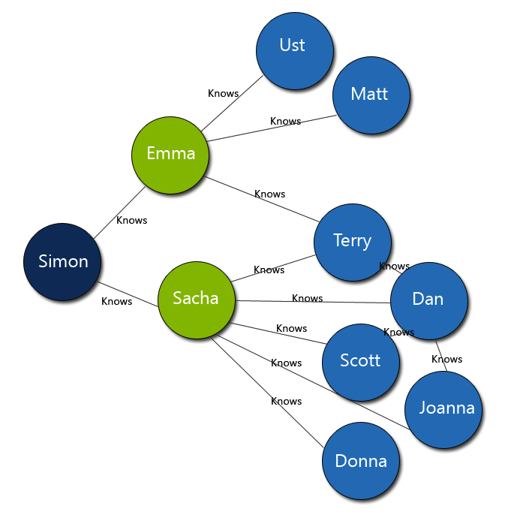
What is Graph Data?
Notes:
What is Graph Data?
What we will be looking at is graphs that look like this where we have a collection of related data known as nodes and relationships between them known as edges.
Graph databases like this have become very popular in the last few years in areas such as supply chain management and sales data analysis.
The recommendation engines that you see on places like Amazon and eBay where it tells you that someone who bought this product also bought this other product are using graph databases.
Facebook and LinkedIn use a graph database to tell you who your 1st, 2nd or 3rd degree friends.
In fact anything where there is connected data can benefit from using a graph database.
And this is what we are looking at today.

Slide 17
So, what is a Graph Database?
A Graph Database is a Database that is modelled as a Graph
Data as it appears in the real world is naturally connected.
Traditional data modeling focuses on entities.
For many applications, there's also a need to model both entities and relationships naturally.
A graph database is a structure that's composed of vertices and edges.

Slide 18
What is a Graph Database
Vertices denote discrete objects, such as a person, a place, or an event.
Edges denote relationships between vertices.
For example,
a person might know another person, be involved in an event, and recently been at a location.

Slide 19
What is a Graph Database
Both vertices and edges can have an arbitrary number of properties.
Properties express information about the vertices and edges.
Example properties include
a vertex that has a name, age, weight
an edge, which has a time stamp or description.

Slide 20
What is a Graph Database
Both vertices and edges can have an arbitrary number of properties.
Properties express information about the vertices and edges.
Example properties include
a vertex that has a name, age, weight
an edge, which has a time stamp or description.

Slide 21
What is a Graph Database
Edges and relationships are first class entities and can have attributes or properties
A single edge can flexibly connect multiple nodes
Easily express pattern matching and multi-hop navigation queries
Supports OLTP and OLAP (analytics) just like SQL databases

Slide 22
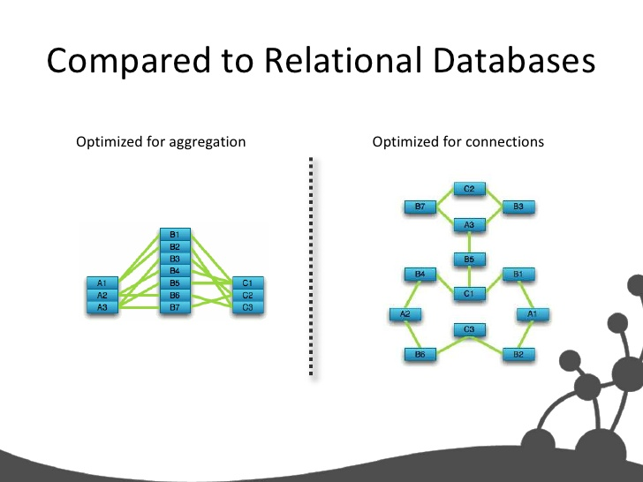

Slide 23
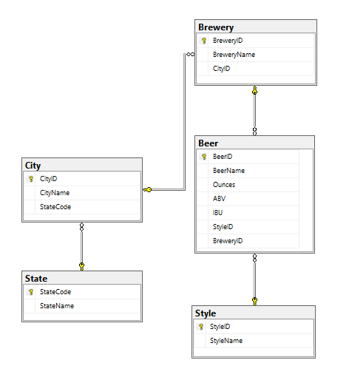

Slide 24
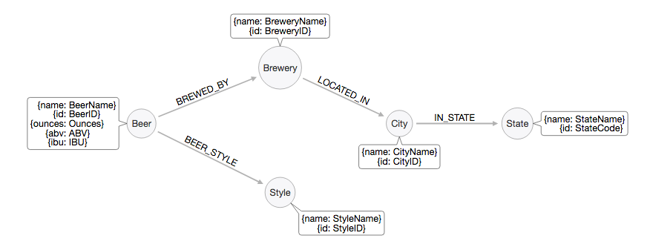

Slide 25
Uses for a Graph Database

Slide 26
Uses for a Graph Database
Common Graph Database Scenarios
Recommendation Systems
Fraud Detection
Content Management
Bill of Materials, product hierarchy
CRM

Slide 27
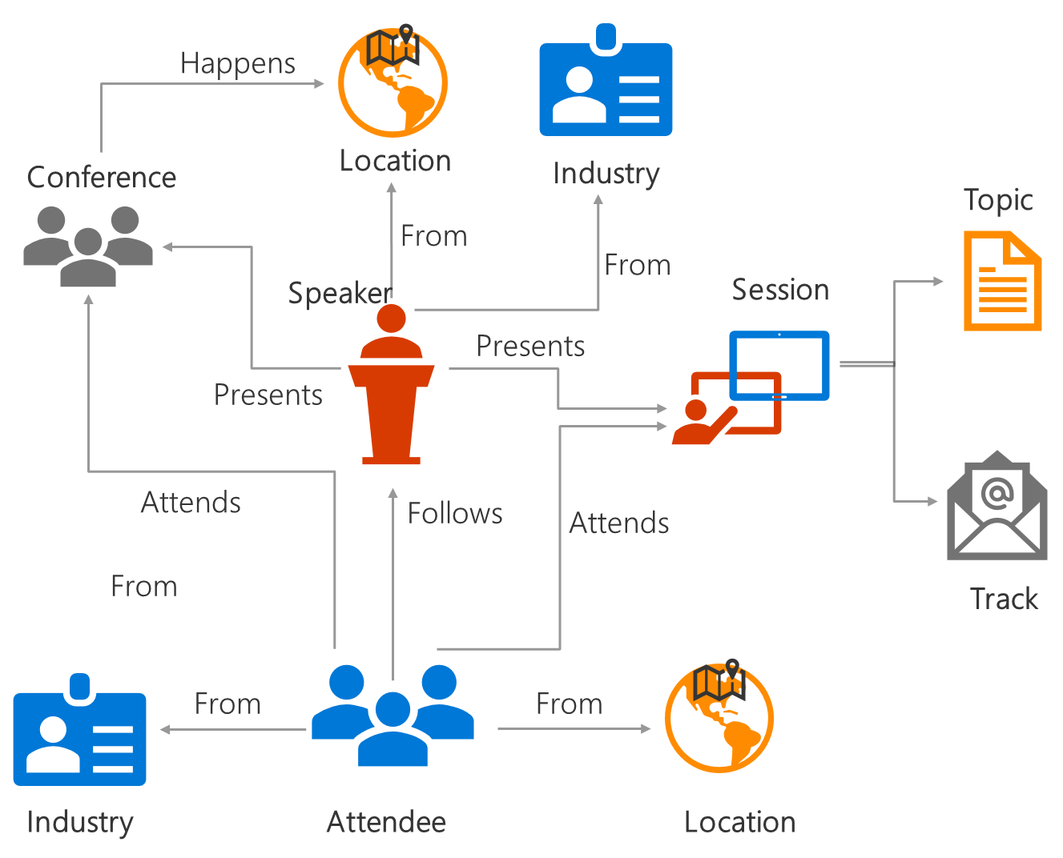
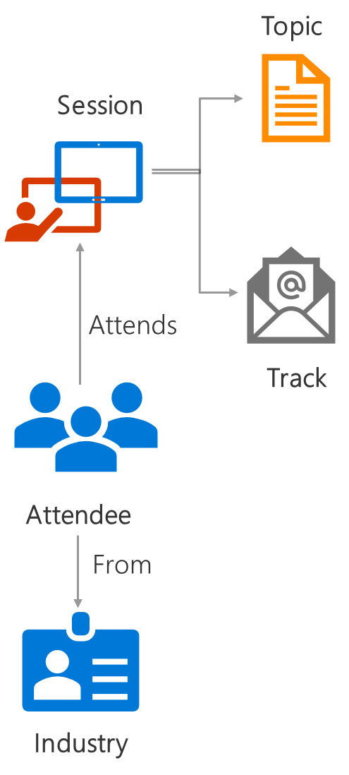
Uses for a Graph Database
John
Mary
Alice
Shaun
Jacob
Jerry
Bob
Natalie
Hierarchical or interconnected data, entities with multiple parents.
Analyze interconnected data, materialize new information from existing facts. Identify non-obvious connections
A
manages
leads
leads
leads
Complex many-to-many relationships. One relation flexibly connecting multiple entities.

Slide 28
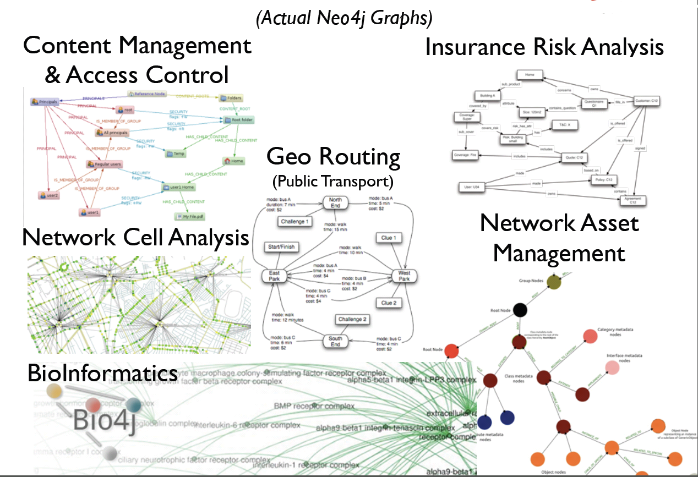
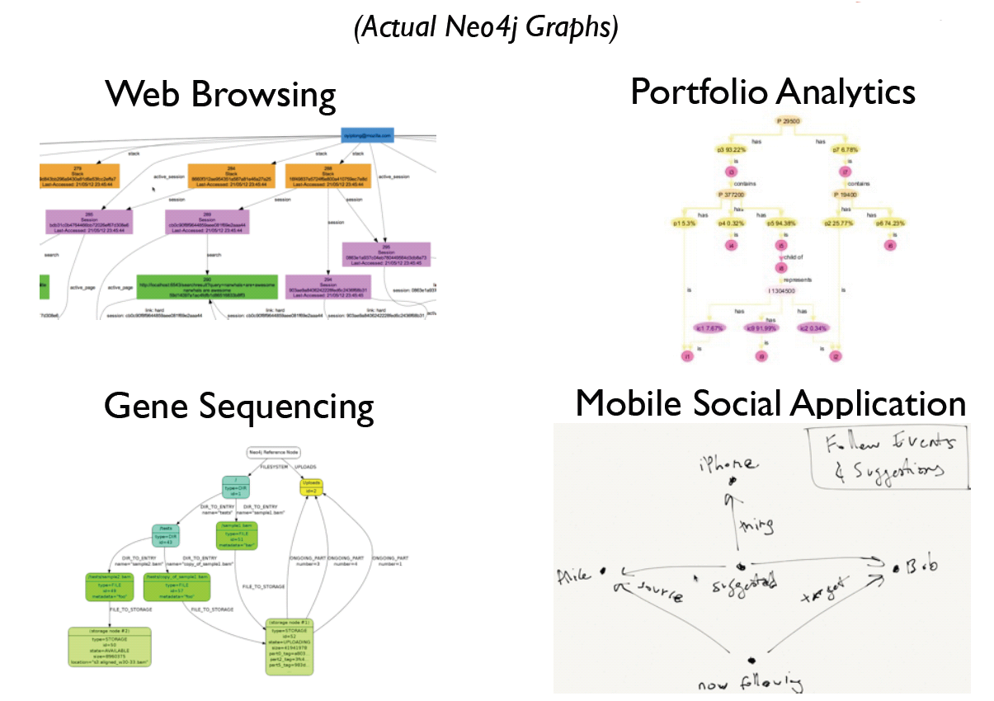
Uses for Graph Databases
https://neo4j.com/blog/analyzing-panama-papers-neo4j/
Notes:
Uses for Graph Databases
As I’ve already said graph databases have a wide variety of uses and as people discover graph and find that it is easier to traverse and query a graph than a traditional relational databases the usage is growing.
These images are taken from Neo4j and show some of the ways that their graph is being used
Content management
Insurance Risk Analysis
Public Transport
BioInformatics
Network Asset Management
Fraud detection
Real-time recommendation engines
Master data management (MDM)
Network and IT operations
Most dating sites now use graph databases.
As do most job websites
Twitter created its own graph database, which it has released as FlockDB as open source.
Neo Technology claims to have more than 30 Global 2000 companies using its technology, including enterprise brands like Wal-Mart, eBay, Lufthansa, and Deutsche Telekom.
The data from the Panama papers, that exposed the financial shenanigans of the rich and powerful was placed into a graph database for analysis.
This allowed the investigators to see connections between related people, their different addresses, shared directorships and the like and see through the fog that many of these people use to try hide what they are doing.
You can see how it was done at https://neo4j.com/blog/analyzing-panama-papers-neo4j/

Slide 29


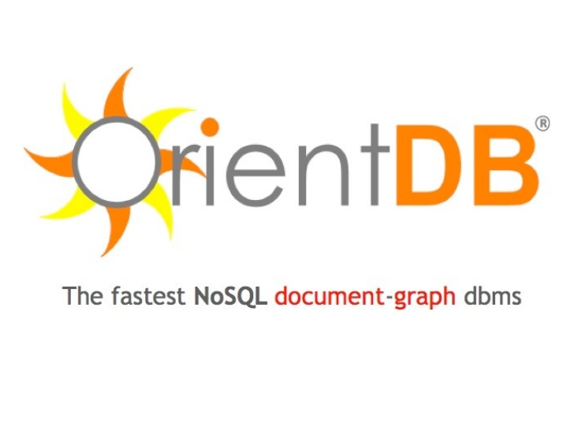





Major Vendors in Graph Database
Neo4j
Orient DB
ArangoDB
Titan
mongoDB
Complexible Stardog
Franz AllegroGraph
Oracle
Notes:
Major Vendors
Microsoft are quite late to the graph database scene
The Graph database is mature market with lots of vendors offering graph database software. Nearly all use open source NoSQL databases
I’ve listed what seem to the most common here
Neo4j by Neo Technologies is definitely the most popular with plenty of videos and articles on graph database. Many of the images and information used in this presentation have come from their web site.
A full list can be found here: https://www.g2crowd.com/categories/graph-databases?utf8=%E2%9C%93&order=top_shelf

Slide 30
When to use a Graph Database
Some potential deciding factors
Application has hierarchical data
While the HierarchyID datatype can be used to implement hierarchies, it has limitations (eg it does not allow multiple parents for a node)
Application has complex many-to-many relationships and as application evolves, new relationships are added.
You need to analyze interconnected data and relationships

Slide 31
Cosmos DB
Notes:
Cosmos DB is Azure’s NoSQL Database-as-a-Service, born in cloud, globally distributed, highly scalable & highly available.
The first & only globally distributed, multi-model database system
2010 Project Florence
2014 DocumentDB
2017 Cosmos DB

Slide 32



Azure Cosmos DB
A globally distributed, massively scalable, multi-model database service
SQL
MongoDB
Table API
Column-family
Document
Key-value
Graph
Guaranteed low latency at the 99th percentile
Elastic scale out
of storage & throughput
Five well-defined consistency models
Turnkey global distribution
Comprehensive SLAs

Slide 33

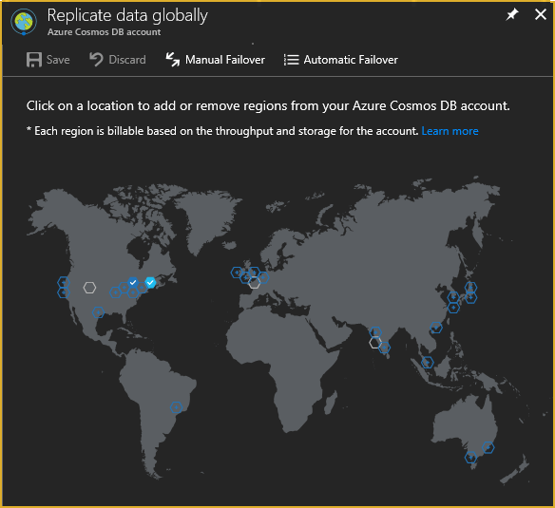
Azure Cosmos DB
A globally distributed, massively scalable, multi-model database service
Global Distribution
Transparent and automatic multi-region replication
Associate any number of regions with your database account, at any time
Policy based geo-fencing
Multi-homing APIs
All endpoints are logical, by default
Apps don’t need to be redeployed during regional failover
Apps can also access physical endpoints if needed
Support for both manual and automatic failover
Designed for high availability
Allows for dynamically setting priorities to regions
Simulate regional disasters via API
Test the end-to-end availability for the entire app (beyond just the database)

Slide 34
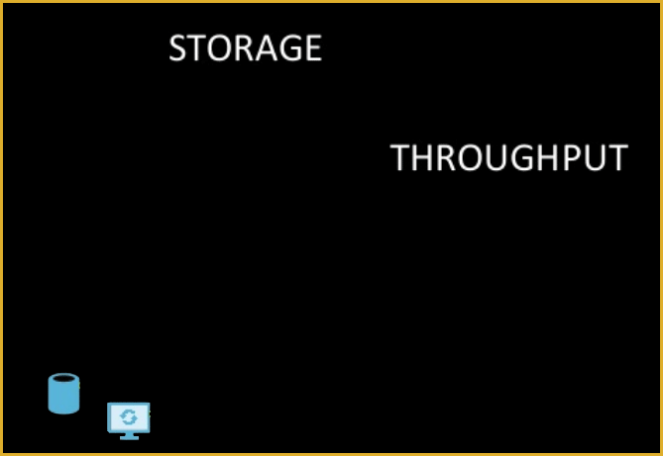
Azure Cosmos DB
A globally distributed, massively scalable, multi-model database service
Global Distribution
Elastic scale-out
Partition management is automatically taken care for you
Independently scale storage and throughput across regions
Scale storage from Gigabytes to Petabytes
Scale throughput from 100s to 100,000,000s of requests/record
Dial down throughput and provision only what is needed

Slide 35
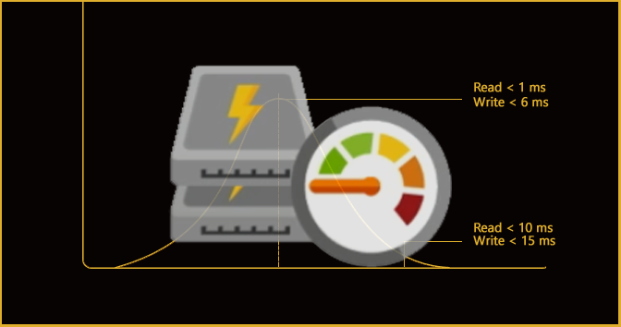
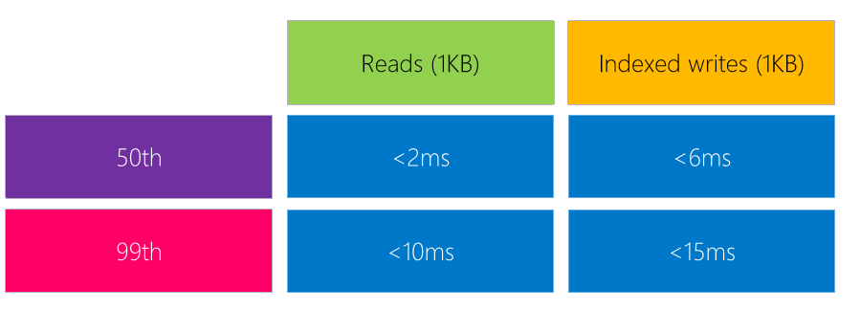
Azure Cosmos DB
A globally distributed, massively scalable, multi-model database service
Global Distribution
Elastic scale-out
Guaranteed single-digit latency
Reads and writes served from local regions
Guaranteed millisecond latency worldwide
Write optimized, latch-free database engine
Automatically indexed SSD storage
Synchronous and automatic indexing at sustained ingestion rates

Slide 36
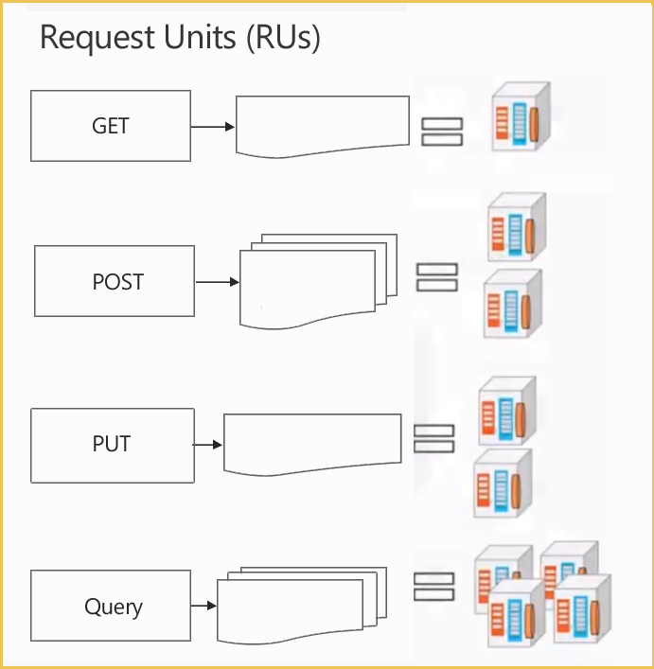
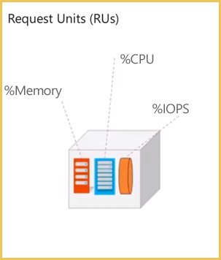
Azure Cosmos DB
A globally distributed, massively scalable, multi-model database service
Global Distribution
Elastic scale-out
What are Azure Cosmos DB - RUs (Request Units)?
Request Units are per seconds
RUs (Request Units) are rate base currency
You reserve in increments of 100
Normalized number representing amount of CPU/Memory/IO Operations
Minimum of 400 for Fixed DB of 10 GB
Reserved compute for processing operations
Minimum of 1000 for Unlimited databases

Slide 37

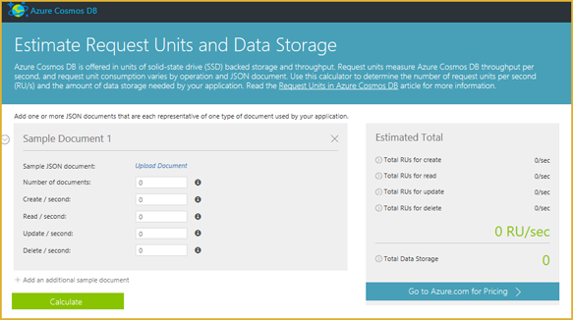
Azure Cosmos DB
A globally distributed, massively scalable, multi-model database service
Global Distribution
Elastic scale-out
Calculating Cosmos DB Request Units (RU) for CRUD and Queries
https://www.documentdb.com/capacityplanner

Slide 38
Azure Cosmos DB
A globally distributed, massively scalable, multi-model database service
Global Distribution
Elastic scale-out
Guaranteed single-digit latency
Reads and writes served from local regions
Guaranteed millisecond latency worldwide
Write optimized, latch-free database engine
Automatically indexed SSD storage
Synchronous and automatic indexing at sustained ingestion rates

Slide 39
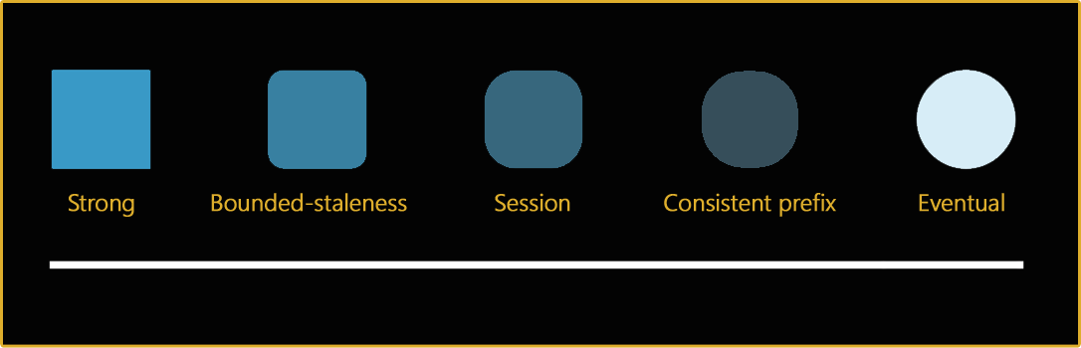






Azure Cosmos DB
A globally distributed, massively scalable, multi-model database service
Global Distribution
Elastic scale-out
Guaranteed single-digit latency
Choice of 5 consistency levels
STRONG: Getting perfect data every time no matter how long it takes
BOUNDED STALENESS: Fetching data that’s not “too old” to boost performance.
SESSION: Putting the individual app user’s experience front and center
CONSISTENT PREFIX: Preserving the order of data writes without too much concern for how old it is
EVENTUAL: Getting whatever you can, whenever you can, as fast as you can
The strong model favors data consistency above all else and preserves the order in which data is written. It guarantees your app users will see all previous writes.
The session model prioritizes the user’s interaction by guaranteeing highly available and consistent data throughout that particular session.
The bounded staleness model ensures relatively accurate data in a more reasonable time frame than strong model.
The eventual model favors app performance above data consistency or write order.
The consistent prefix model favors performance and availability without sacrificing the sequence of events by fetching old data fast
When you choose the bounded staleness model, you are saying it’s okay for apps to fetch old data from local replicas provided it’s not more than x versions older than a primary or peer.
When you choose the eventual model, you’re saying it doesn’t matter what order data is read as long as something is available.
Data that fetches under the eventual model offers the lowest latency for both reads and writes but it also provides the weakest consistency.
When you choose the consistent prefix model, you’re saying it’s okay to give your app users old data as long as the data read observes the actual sequence of writes. This differs from the eventual model in that it reflects the order of writes as they occurred.
Session consistency provides predictable read-your-own-write consistency for a given session with maximum read throughput while preserving low latency writes and reads. Consistency within a given session is strong, while consistency outside the given session is eventual.
When you choose the strong model, you ask your app users to wait until all data writes have been fully written in the master and made durably available. Your app users get an error message if their request comes before the data is ready.
The bounded staleness model is great for apps that can afford a little lag time in favor odd data consistency.
The eventual model is great for apps that live and die according to their availability.
The strong model is great if you need your app users to read the absolute truth every time.
Flight status apps provide flight arrival time estimations using GPS data collected from planes as they fly. The GPS data doesn’t have to be the most up to date to provide a reasonable estimation.
It’s more important that the user get information when they need it.
Product reviews have to be available for customers to reach when they want them but
it’s not crucial that the reviews always include the latest ratings or preserve the order of the ratings.
Baseball score updates running at the bottom of ESPN must appear in the order that they occurred during the game at the expense of being up-to-the minute accurate
The session model is great for apps that require logical and real-time experiences for the user.
Banking accounts need to reflects the order of transactions and provide an accurate balance, so team members in
different offices don’t pay the same bill twice.
Profile updates your user writes to her account must be immediately available for her to read,
whereas it’s less important for her to read profile updates other users are writing simultaneously.
Social media wall posts (not the comments to a post, but the initial post itself) just need to show up eventually.
Users care more about seeing activity when they’re on the site then they care about seeing the order of the activity.
It’s okay if, later on, the posts reorder or repopulate in their feed as long as there’s something new to see now.
Social media comments must be ordered to preserve the back-and-forth nature of dialogue and make sense to people reading them, but the reads do not need to be fully up-to-date.
As a result, the cost of read operations (in terms of system resources) are lower than Session, Bounded Staleness and Strong.
Package tracking apps for a shipping company need to provide chronologically ordered and check points that show where and when a package is received.
Payment processing for online orders need to occur in the correct order especially to avoid charging for the same order more than once.
Social music apps such as Spotify need to be consistent with users’ playlists preferences as they are building them,
but the preferences don’t have to show up right away for everyone else who is “following.”
Transaction receipts don’t necessarily need to be available immediately after purchase,
as long as they show up within a reasonable window of time.
Reservation systems must show accurate availability when customers finalize their booking.

Slide 40

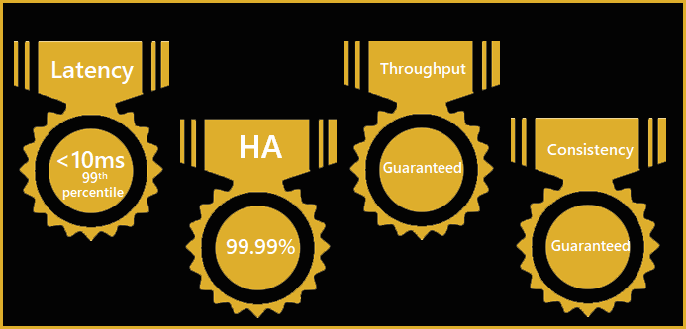
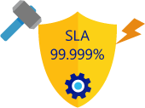

Azure Cosmos DB
A globally distributed, massively scalable, multi-model database service
Global Distribution
Elastic scale-out
Guaranteed single-digit latency
Choice of 5 consistency levels
Enterprise level SLAs
Only service with financially backed SLAs for millisecond latency
at the 99th percentile, 99.99% HA (High Availability) and guaranteed throughput and consistency

Slide 41
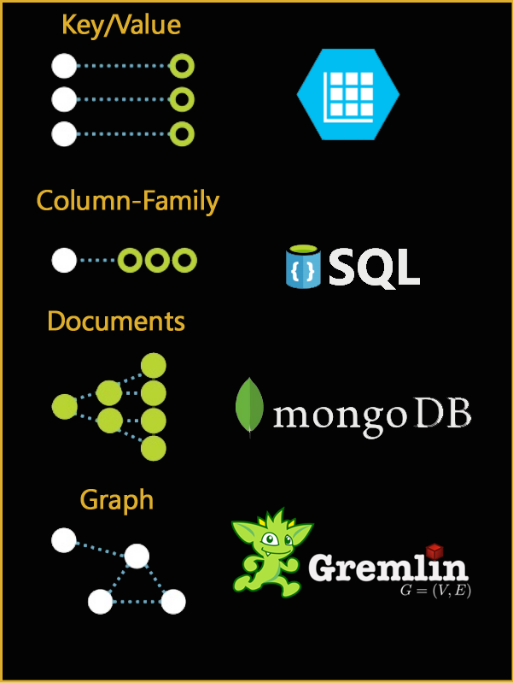
Azure Cosmos DB
A globally distributed, massively scalable, multi-model database service
Global Distribution
Elastic scale-out
Guaranteed single-digit latency
Choice of 5 consistency levels
Enterprise level SLAs
Multi-model + multi API
Database engine operates on atom-record-sequence (ARS) based type system
All data models are efficiently translated to ARS
API and wire protocols are supported via extensible modules
Instance of a given data model can be materialized as trees
Graph, documents, key-value, column-family, … more to come

Slide 42
Gremlin - Apache TinkerPop
Notes:
Apache TinkerPop™ is an open source, vendor-agnostic, graph computing framework distributed under the commercial friendly Apache2 license. When a data system is TinkerPop-enabled, its users are able to model their domain as a graph and analyze that graph using the Gremlin graph traversal language.

Slide 43
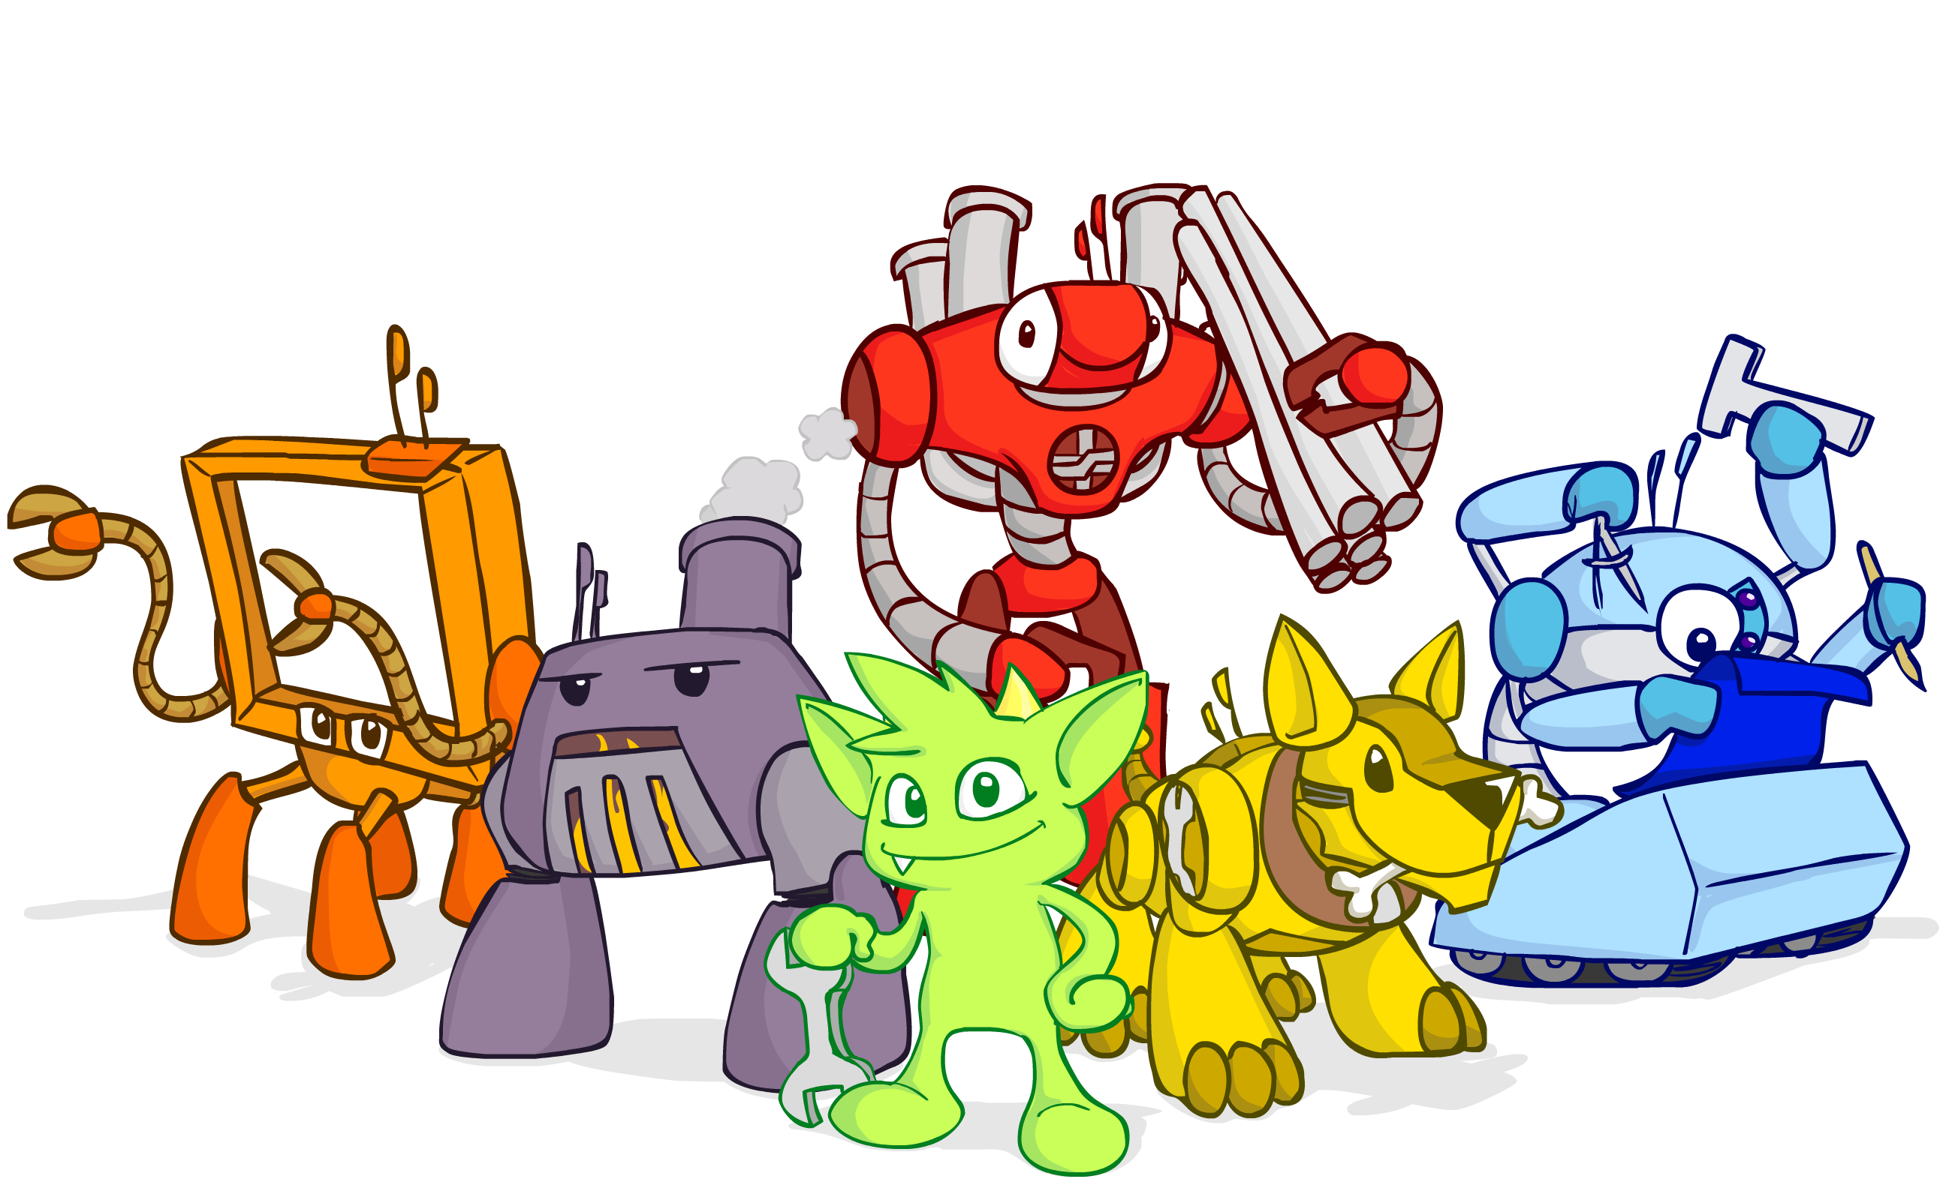
Apache TinkerPop™ is an open source, vendor-agnostic, graph computing framework distributed under the commercial friendly Apache2 license.
When a data system is TinkerPop-enabled, its users are able to model their domain as a graph and analyze that graph using the Gremlin graph traversal language.

Slide 44
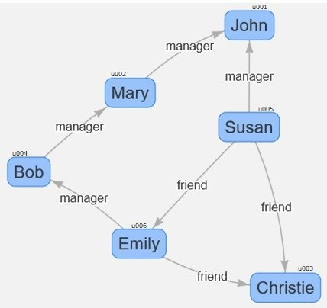
Simple Graph Example

Slide 45
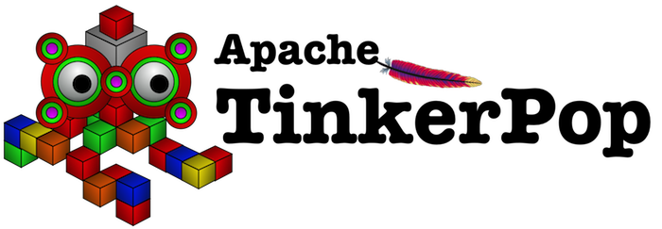
Populating Content

Slide 46
Create the vertices (nodes).
g.addV('employee').property('id', 'u001').property('firstName', 'John').property('age', 44)
g.addV('employee').property('id', 'u002').property('firstName', 'Mary').property('age', 37)
g.addV('employee').property('id', 'u003').property('firstName', 'Christie').property('age', 30).property('FavouriteColour', 'Blue')
g.addV('employee').property('id', 'u004').property('firstName', 'Bob').property('age', 35)
g.addV('employee').property('id', 'u005').property('firstName', 'Susan').property('age', 31)
g.addV('employee').property('id', 'u006').property('firstName', 'Emily').property('age', 29).property('cat','Bustopher Jones')

Slide 47
Create the edges between vertices.
g.V('u002').addE('manager').to(g.V('u001’))
g.V('u005').addE('manager').to(g.V('u001’))
g.V('u004').addE('manager').to(g.V('u002’))
g.V('u005').addE('friend').to(g.V('u006’))
g.V('u005').addE('friend').to(g.V('u003’))
g.V('u006').addE('friend').to(g.V('u003’))
g.V('u006').addE('manager').to(g.V('u004'))

Slide 48
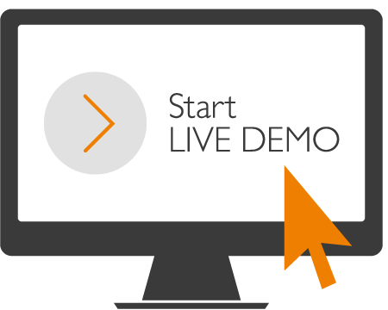
Notes:
Demo’s of Backup Script
Maintenance Plans Ola Hallengren
Minion Backup

Slide 49
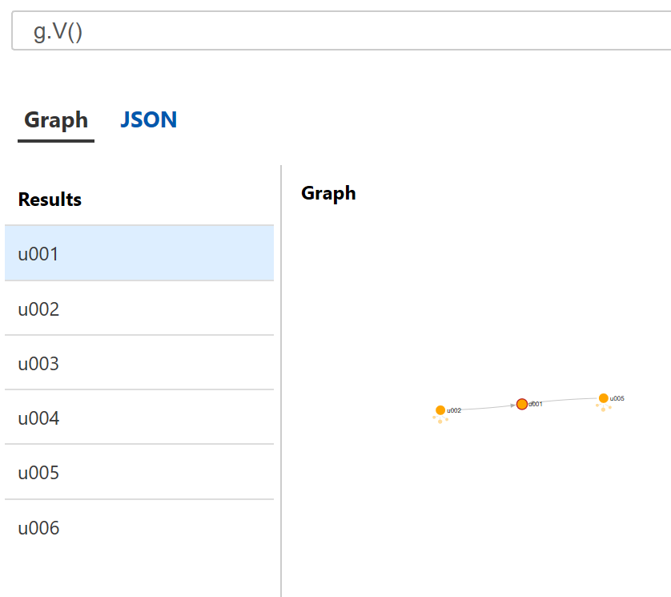
Gremlin Examples:
g.V()

Slide 50
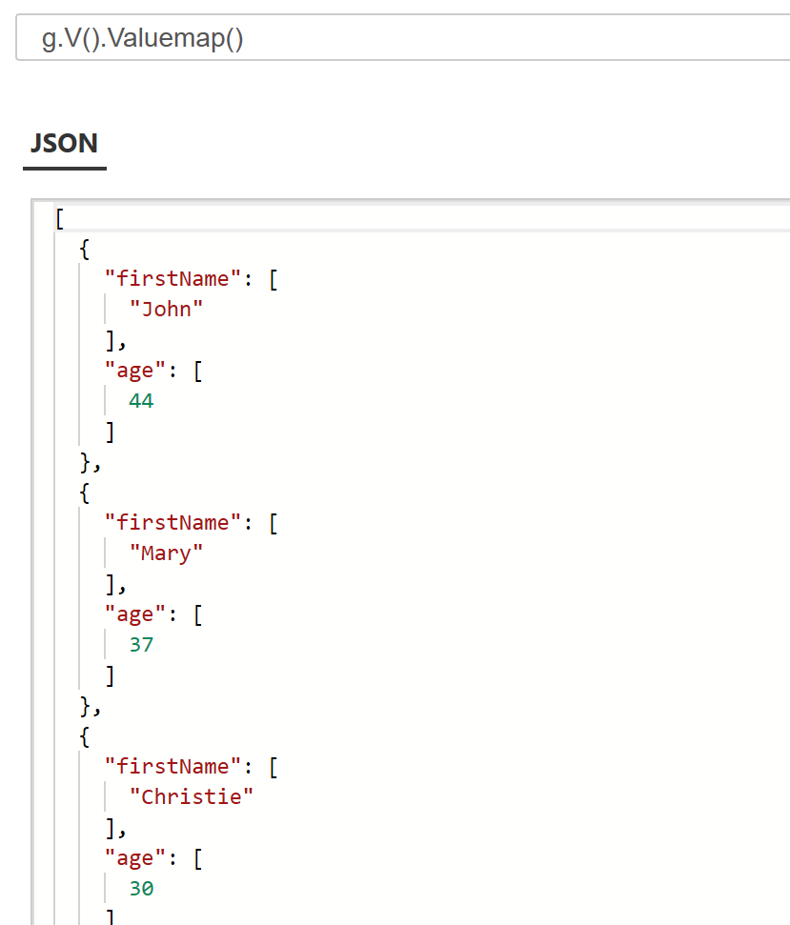
Gremlin Examples:
g.V().valueMap()

Slide 51
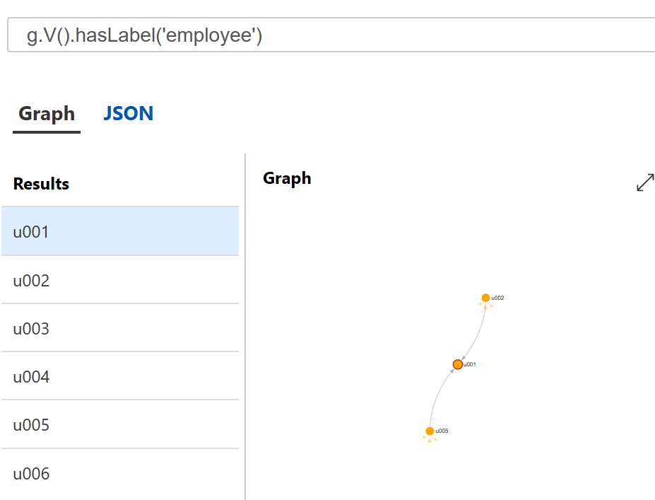
Gremlin Examples:
g.V().hasLabel('employee')

Slide 52
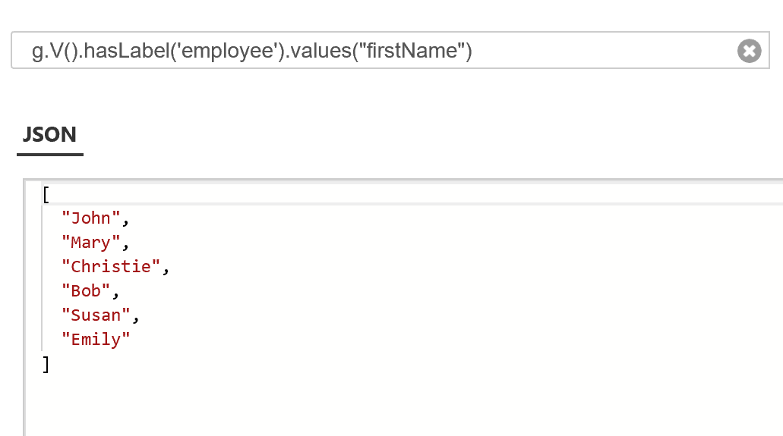
Gremlin Examples:
g.V().hasLabel('employee').values("firstName")

Slide 53
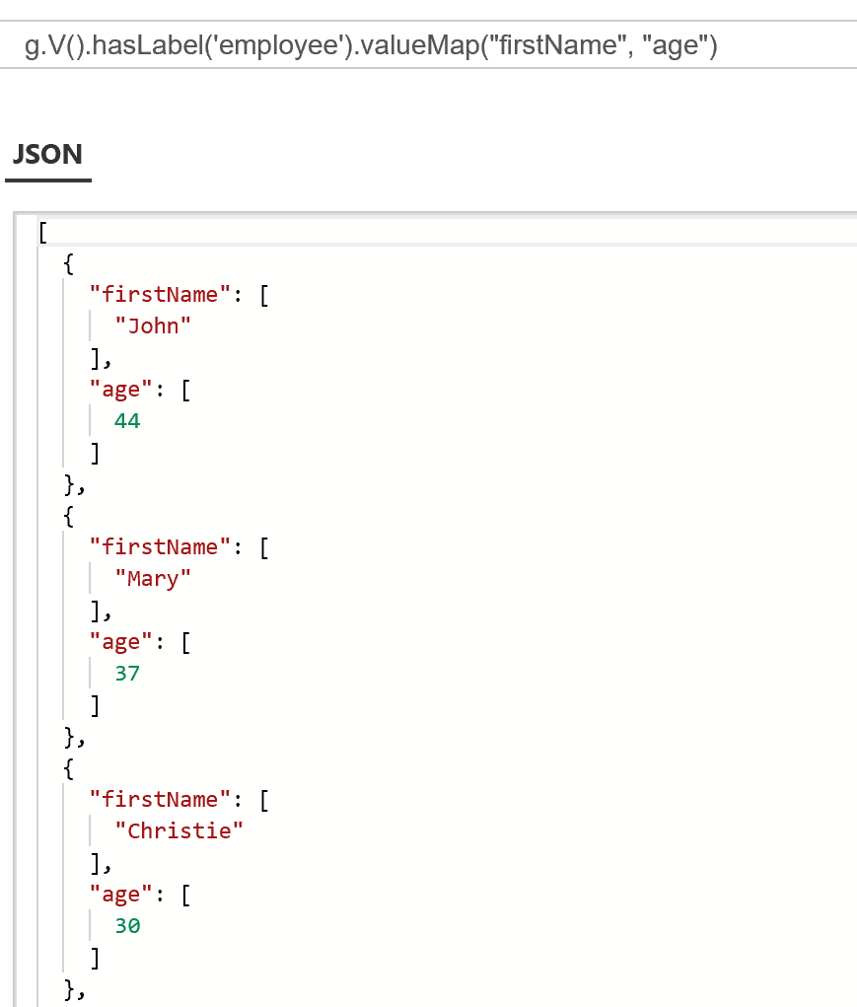
Gremlin Examples:
g.V().hasLabel('employee').valueMap("firstName", "age")

Slide 54
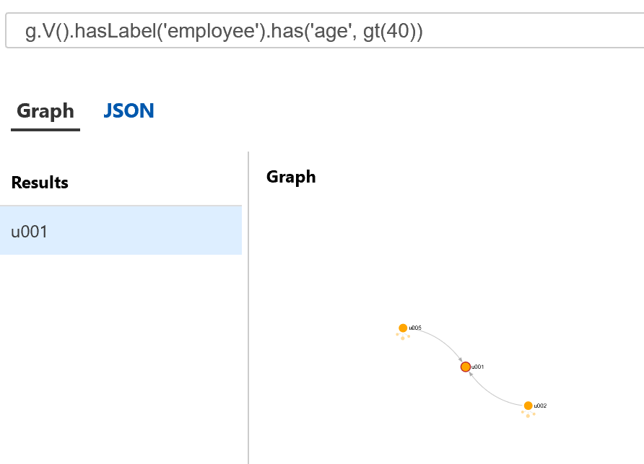
Gremlin Examples:
g.V().hasLabel('employee').has('age', gt(40))

Slide 55
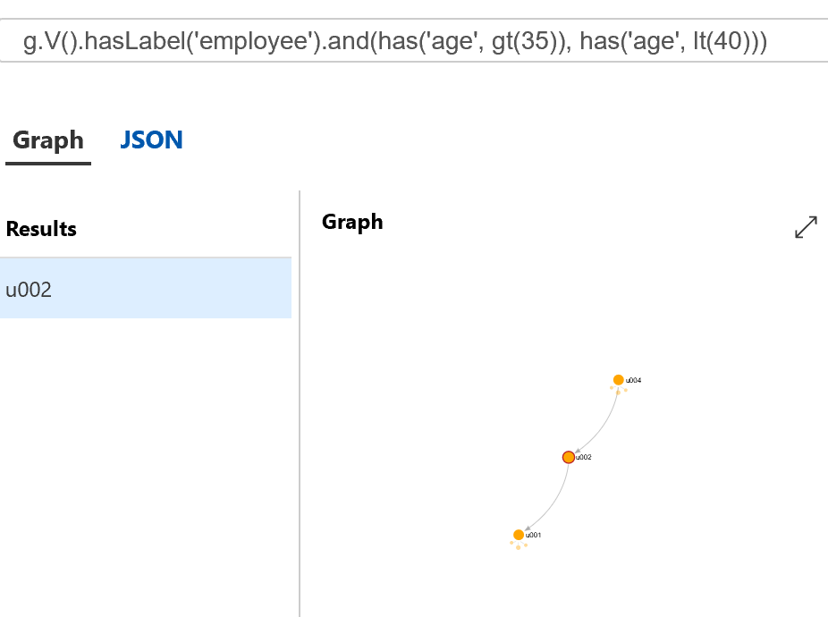
Gremlin Examples:
g.V().hasLabel('employee').and(has('age', gt(35)), has('age', lt(40)))

Slide 56
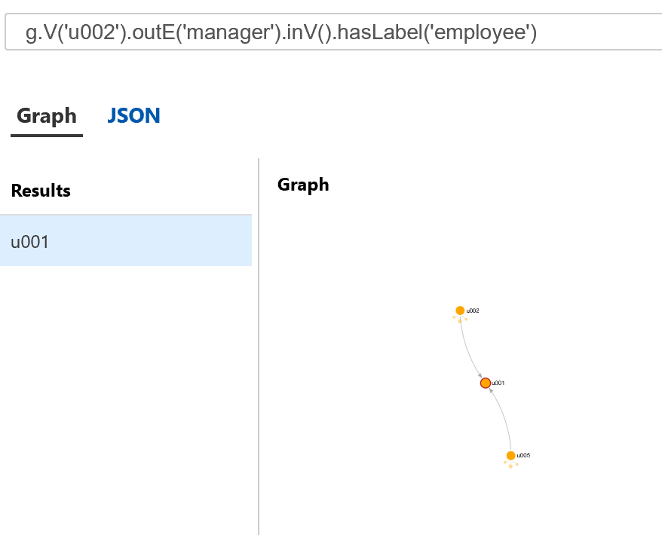
Gremlin Examples:
g.V('u002').outE('manager').inV().hasLabel('employee')

Slide 57
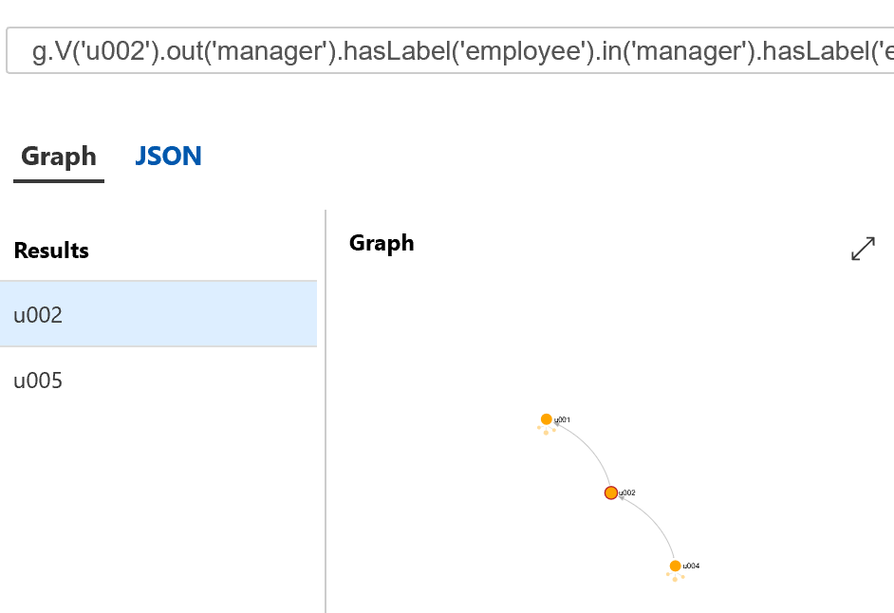
Gremlin Examples:
g.V('u002').out('manager').hasLabel('employee').in('manager').hasLabel('employee')

Slide 58
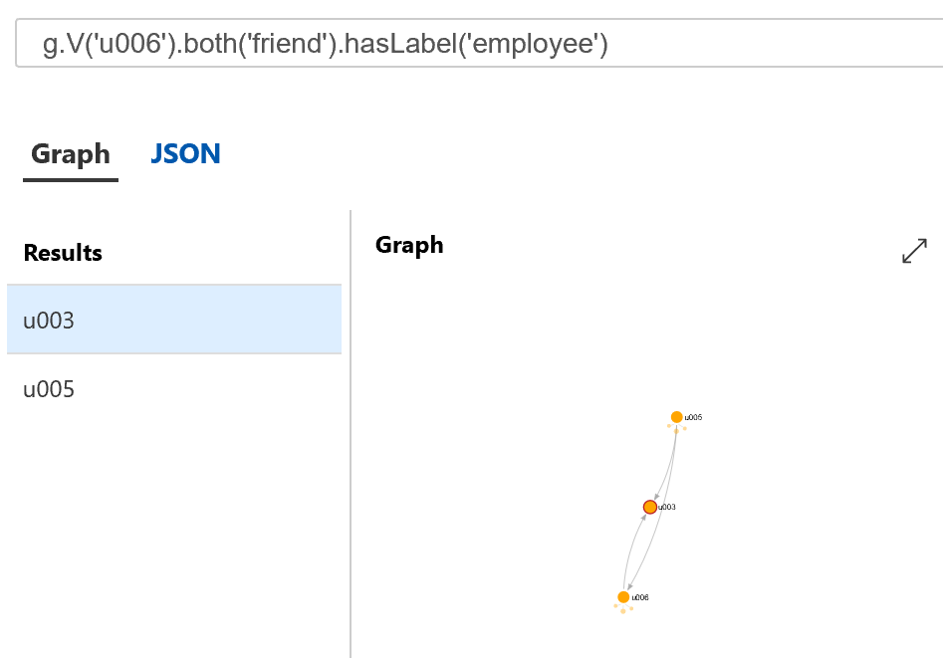
Gremlin Examples:
g.V('u006').both('friend').hasLabel('employee')

Slide 59
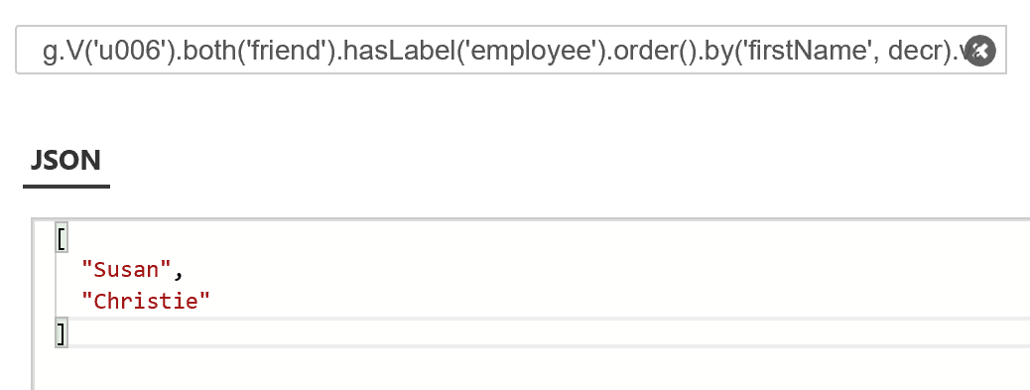
Gremlin Examples:
g.V('u006').both('friend').hasLabel('employee').order().by('firstName', decr).values("firstName")

Slide 60
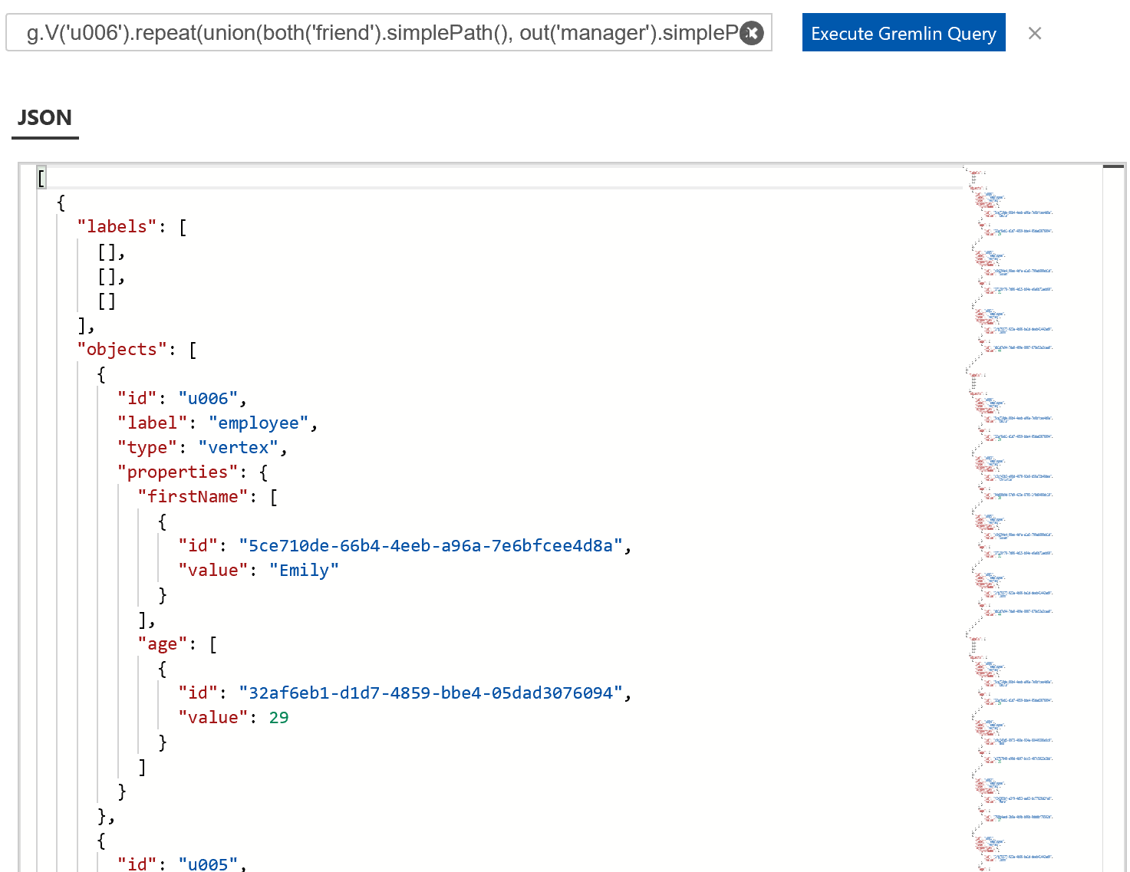
Gremlin Examples:
g.V('u006').repeat(union(both('friend').simplePath(), out('manager').simplePath())).until(has('id', 'u001')).path()

Slide 61

Gremlin Examples:
g.V('u006').repeat(union(both('friend').simplePath(), out('manager').simplePath())).until(has('id', 'u001')).path().count(local)

Slide 62

Gremlin Examples:
g.E().hasLabel('friend')

Slide 63
Update and Delete
-- Update
g.V().hasLabel('employee').has('firstName','John').property('age', 45)
-- Delete Vertex
g.V('u006').drop()
-- Delete Edge
g.V('u006').outE('friend').drop

Slide 64
Social
Make sure you tweet on #SQLSat784 or #SQLSatSingapore
Don’t forget to thank Volunteers and other Speakers!

Slide 65
Azure Cosmos DB Graph Links
https://docs.microsoft.com/en-us/azure/cosmos-db/graph-introduction
https://docs.microsoft.com/en-us/azure/cosmos-db/gremlin-support
https://docs.microsoft.com/en-us/azure/cosmos-db/create-graph-gremlin-console
https://aka.ms/CosmosDBlearn
https://vincentlauzon.com/2017/08/28/cosmos-db-graph-with-gremlin-getting-started/
https://tsmatz.wordpress.com/2017/07/04/azure-cosmos-db-gremlin-graph-tutorial/
https://vincentlauzon.com/2017/08/28/cosmos-db-graph-with-gremlin-getting-started/

Slide 66
Apache TinkerPop - Gremlin
http://tinkerpop.apache.org/
http://tinkerpop.apache.org/docs/current
http://tinkerpop.apache.org/gremlin.html
http://kelvinlawrence.net/book/Gremlin-Graph-Guide.html

Slide 67
Social
Make sure you tweet on #SQLSat750
Don’t forget to thank Sponsors and Volunteers

Slide 68
Questions?
?
?
?
?
?
?
?
?
?
?
?
?
?
?
?
?

Slide 69
Final Thoughts

